Slide 1



Predicting Movie Success:
A Data-Driven Approach to Maximize Return of Investment (ROI)
Presented by
Hariharan K, Jawahar S

Slide 2
INTRODUCTION
📌 What is this project about?
This project predicts the probability of a movie achieving a high Return on Investment (ROI) based on past data.
📌 Why is it important?
Helps movie producers make data-driven decisions on genre, director, cast, and other key factors. Increases the chances of creating a profitable movie by analyzing historical trends.
📌 How does it work?
Collects movie data and cleans it. Calculates ROI and defines high ROI movies. Analyzes probabilities of success based on features like genre, director, and country.

Slide 3
PROBLEM
📌 The Challenge
The film industry is highly unpredictable, with many movies failing to generate a high return on investment (ROI).
Producers struggle to determine the right combination of factors (genre, cast, director, country, and rating) that contribute to profitability.
Traditional decision-making relies on intuition rather than data-driven insights.
📌 Why This Matters
A poor selection of movie attributes can lead to financial losses.
The need for a predictive system that uses historical data to recommend the best choices for maximizing profitability.

Slide 4
OBJECTIVE
📌 Goal of the Project
Develop a data-driven decision engine to predict the profitability of movie projects.
📌 Key Objectives
Analyze past movie data to identify patterns in successful films.
Calculate probabilities of high ROI based on key factors like genre, director, writer, cast, country, and rating.
Provide dynamic user input analysis to help producers make informed decisions.
4. Enhance investment strategies by selecting the most promising movie attributes.

Slide 5
METHODOLOGY
Qualitative
Quantitative
🔹 Data Collection – Gathering movie-related data (budget, gross, genre, director, etc.).
🔹 Data Cleaning – Removing missing values, handling inconsistent formats, and filtering irrelevant records.
🔹 Feature Selection – Identifying key factors that impact ROI (e.g., genre, star power, release country).
🔹 User Interaction – Allowing dynamic user input for personalized predictions.
📊 ROI Calculation:
ROI = (Gross−Budget) / Budget
High ROI defined as the top 25% of movies.
📈 Probability Analysis Compute probability of high ROI for:
✅ Genre ✅ Director
✅ Writer ✅ Star
✅ Country ✅ Rating
🔢 User-Based ROI Prediction:
User enters movie parameters, system filters dataset, and calculates historical probability of success.

Slide 6
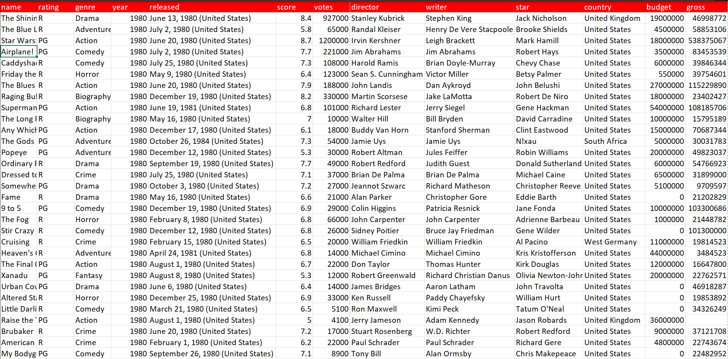
WORKING DATASET

Slide 7
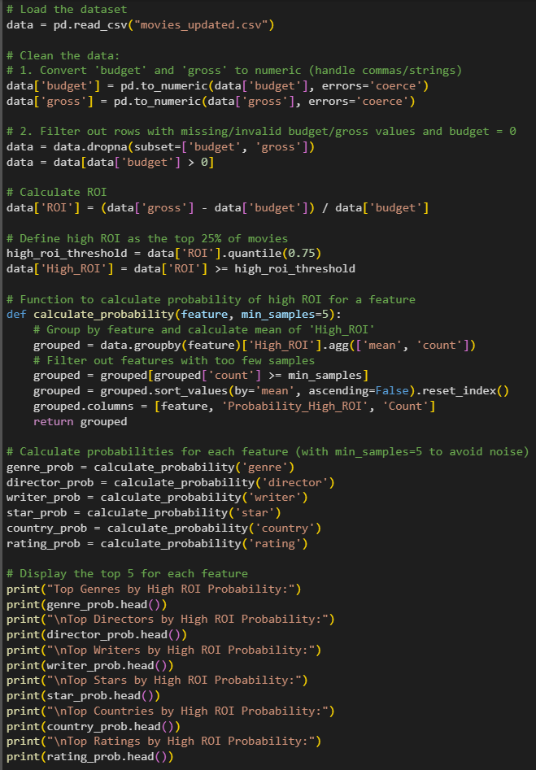

WORKING CODE:

Slide 8
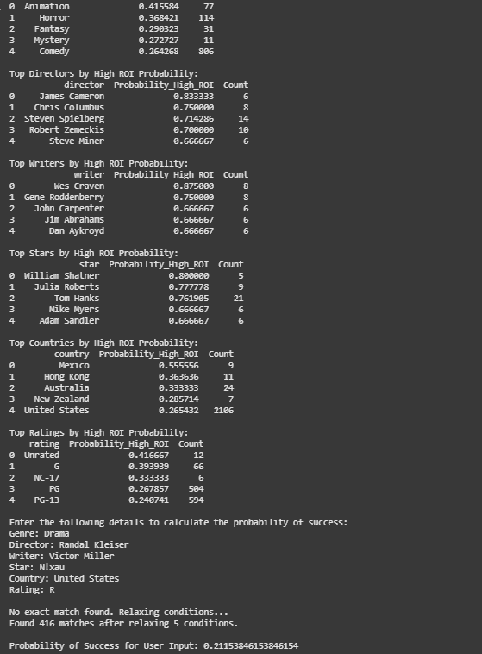
OUTPUT:

Slide 9
RESULT
Key Findings:
Feature-Wise Probability of High ROI
Genre: Identifies the most profitable movie types.
Director & Writer: Highlights creators with a history of success.
Star Power: Evaluates actors based on their past box office impact.
Country & Rating: Determines optimal market and target audience.
Quantitative Analysis:
Top 25% ROI movies classified as ‘High ROI’.
User-Input Prediction:
Calculates the probability of success for a given movie concept.
Data-Driven Insights:
Helps producers make informed investment choices.
Overall Impact
Enables risk minimization & ROI maximization for movie production.
Support strategic decision-making based on historical performance.

Slide 10
CONCLUSION
Data-Driven Decision Making:
The model helps producers select movie attributes that maximize Return on Investment (ROI).⿢
Predictive Insights for Success:
Uses historical data & machine learning to predict the profitability of different movie features.⿣
Future Enhancements:
Integrating advanced AI techniques & larger datasets for even more accurate predictions.

Slide 11








